Slide 1
Security Protocols
Lesson Introduction
Authentication protocols
Key exchange protocols
Kerberos
Notes:
Security protocols are the foundation of secure network applications.
In the lesson, we will discuss authentication protocols, key exchange protocols, and Kerberos.

Slide 2

Why Security Protocols
Alice and Bob want to communicate securely over the Internet, they need to:
(Mutually) authenticate
Establish and exchange keys
Agree to cryptographic operations and algorithms
Building blocks:
Public-key (asymmetric) and secret-key (symmetric) algorithms, hash functions
Notes:
A network protocol defines the rules and conventions for communications between two entities.
A security protocol defines the rules and conventions for SECURE communications.
What are these rules and conventions?
Suppose Alice and Bob want to communicate securely over the Internet, which is not secure. Typical, by secure communications, we mean some combination of authentication of both parties, message confidentiality, integrity, and authenticity. To accomplish these goals, we need to use the asymmetric and symmetric encryption algorithms and hash functions as building blocks, and Alice and Bob need to authenticate each other, establish and exchange keys and agree to the cryptographic operations and algorithms that they use.

Slide 3
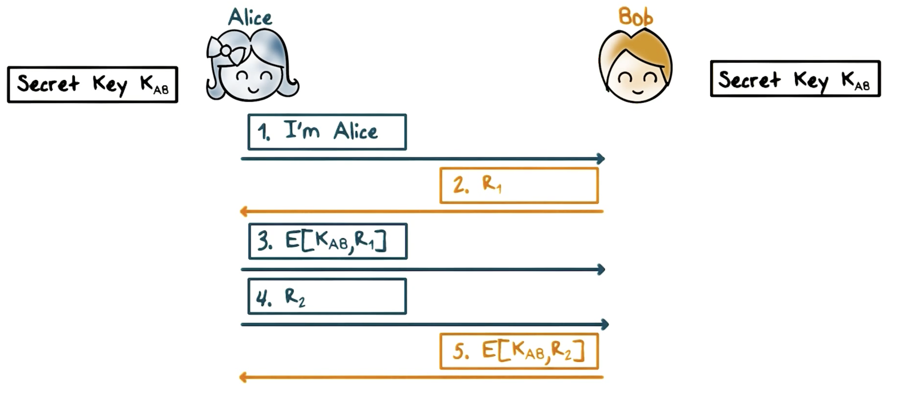
Mutual Authentication: Shared Secret
Notes:
Let’s take a look at authentication, that is, Alice needs to prove to Bob that she is really Alice and vice versa, Bob needs to prove to Alice that he is Bob.
Suppose that Alice and Bob share a secret key K_AB, that is, only Bob and Alice know this key.
Here is an authentication protocol using symmetric cryptography:
First, Alice says I’m Alice;
Second, Bob says to Alice: prove it, by sending a random value R_1, which we call it the challenge;
Third, Alice, then encrypts R_1 using the shared key K_AB and sends Bob the ciphertext, which we call it the response; when Bob receives the response, he decrypts it and see if it matches the plaintext R_1 that he sent to Alice, and if it matches, he knows that the party he is communicating with must be Alice because other than himself, only Alice knows the shared key K_AB, and without K_AB, R_1 cannot be encrypted properly, that is, the ciphertext he receives won’t be decrypted back to R_1;
Fourth, now it is Alice’s turn to authenticate Bob, so, similarly, she sends Bob a random challenge R_2;
Fifth, Bob encrypts R_2 with the shared key K_AB and sends the ciphertext to Alice; upon receiving the response from Bob, Alice decrypts the ciphertext if the result matches the plaintext R_2 that she sent to Bob, she knows that the party she is communicating with must be Bob.
Note that if only one-way authentication is required, for example, Alice is a client and needs to authenticate to Bob, which is a server, but Bob does not need to authenticate to Alice, then only the first three steps of the protocol are used, and if Alice is a human user, the key K_AB can be derived from her password hash, which is known to Bob.

Slide 4

Mutual Authentication: Shared Secret
R₁ and R₂ should not be easily repeatable and predictable
Otherwise an adversary, Trudy, can record and replay challenge and/or response to impersonate Alice or Bob
Use large random values
K_{AB} needs to be protected at Alice and Bob (end points of communication)
Notes:
It is important for challenges R_1 and R_2 to be not easily repeatable or predictable. Otherwise, Trudy can record the challenge and response between Alice and Bob and replay them to impersonate Alice or Bob. For example, Trudy tries to impersonate Alice and Bob happens to send R_1 as the challenge, which was used previously and recorded by Trudy, then Trudy can just send the recorded response, that is, the ciphertext of R_1 to Bob and Bob will be tricked to believe that she is Alice. As another example, supposed that the challenges always increase in values. Then Trudy can first impersonate Bob and send a larger challenge R_1 = 1000 and record the response from Alice. Meanwhile, the real Bob is using a smaller R_1 = 950. Then Trudy can impersonate Alice sometime in the future when the real Bob finally sends R1=1000.
In practice, R_1 and R_2 should be large random values so that they are not predictable and the chance of repeats is very small.
Another security precaution is that the shared secret key K_AB needs to be protected because Trudy steals a copy of the key from one of the communication end points, that is, at Alice or Bob, she can impersonate either Alice or Bob.

Slide 5
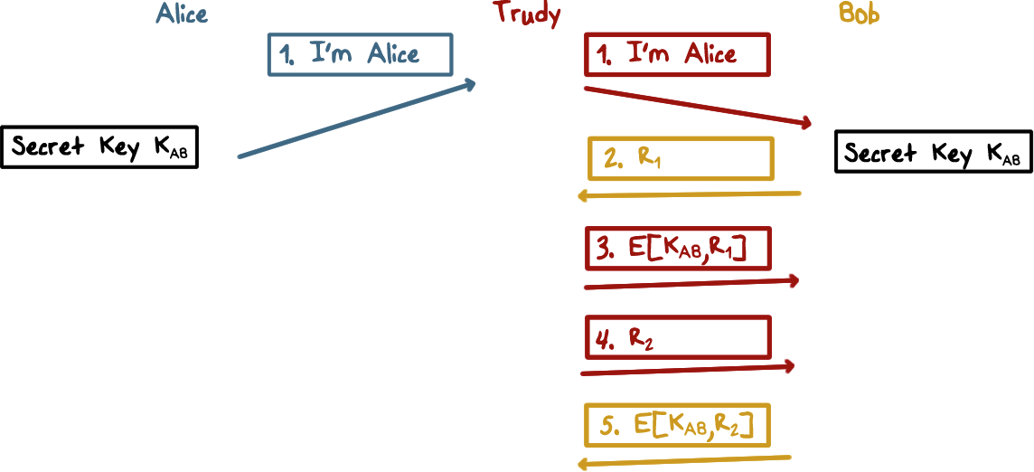
Mutual Authentication: Shared Secret
Notes:
Also, it is important for challenges R_1 and R_2 to be not easily repeatable or predictable. Otherwise, Trudy can record the challenge and response between Alice and Bob and replay them to impersonate Alice or Bob. For example, Trudy tries to impersonate Alice and Bob happens to send R_1 as the challenge, which was used previously and recorded by Trudy, then Trudy can just send the recorded response, that is, the ciphertext of R_1 to Bob and Bob will be tricked to believe that she is Alice. As another example, supposed that the challenges always increase in values. Then Trudy can first impersonate Bob and send a larger challenge R_1 = 1000 and record the response from Alice. Meanwhile, the real Bob is using a smaller R_1 = 950. Then Trudy can impersonate Alice sometime in the future when the real Bob finally sends R1=1000.

Slide 6

Mutual Authentication Quiz
Mark T for True or F for False:
The challenge values used in an authentication protocol can be repeatedly used in multiple sessions
The authentication messages can be captured and replayed by an adversary
Authentication can be one-way, e.g., only authenticating Alice to Bob
Notes:
Quiz:
Discuss
----
Solution:
1. False; 2. True; 3. True.

Slide 7
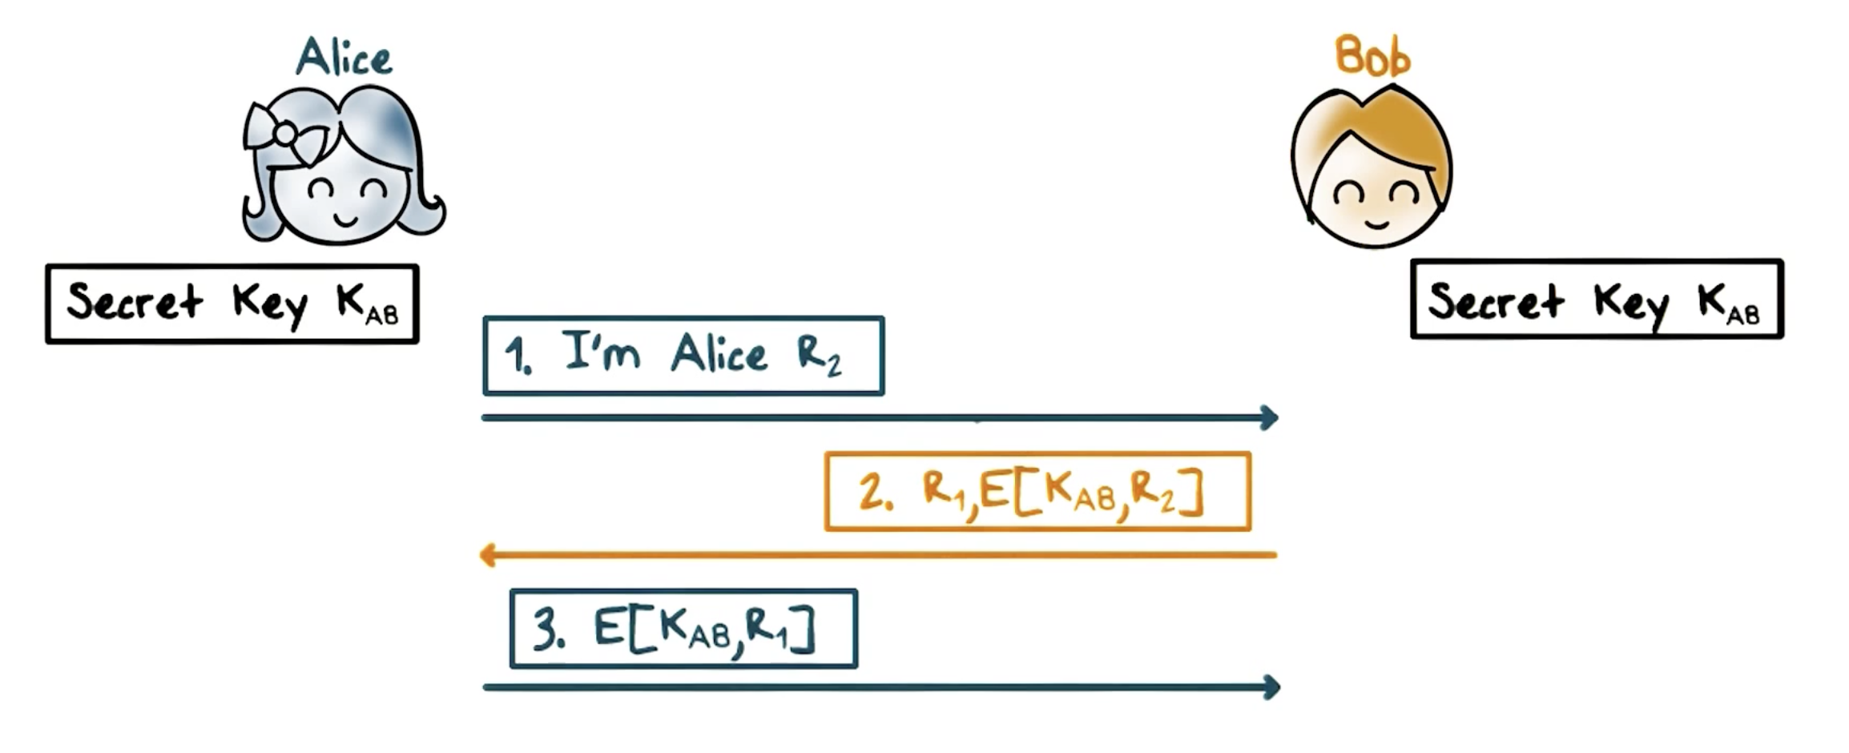
Mutual Authentication: Simplified
Notes:
The mutual authentication protocol takes five steps. Can we simply it? That is, can we use fewer steps.
It seems that the following would work:
First, Alice says Hi to Bob and sends along a challenge R_2;
Second, in response, Bob sends Alice the ciphertext of R_2 and his own challenge R_1; upon receiving this response Alice decrypts the ciphertext and see if it matches the plaintext R_2 that she had sent to Bob, if it matches, then she knows that she is communicating with Bob;
Third, Alice then sends Bob a ciphertext of R_1; and Bob decrypts it and matches with the plaintext R_1 to authenticate Alice.
Is there anything wrong with this protocol?

Slide 8
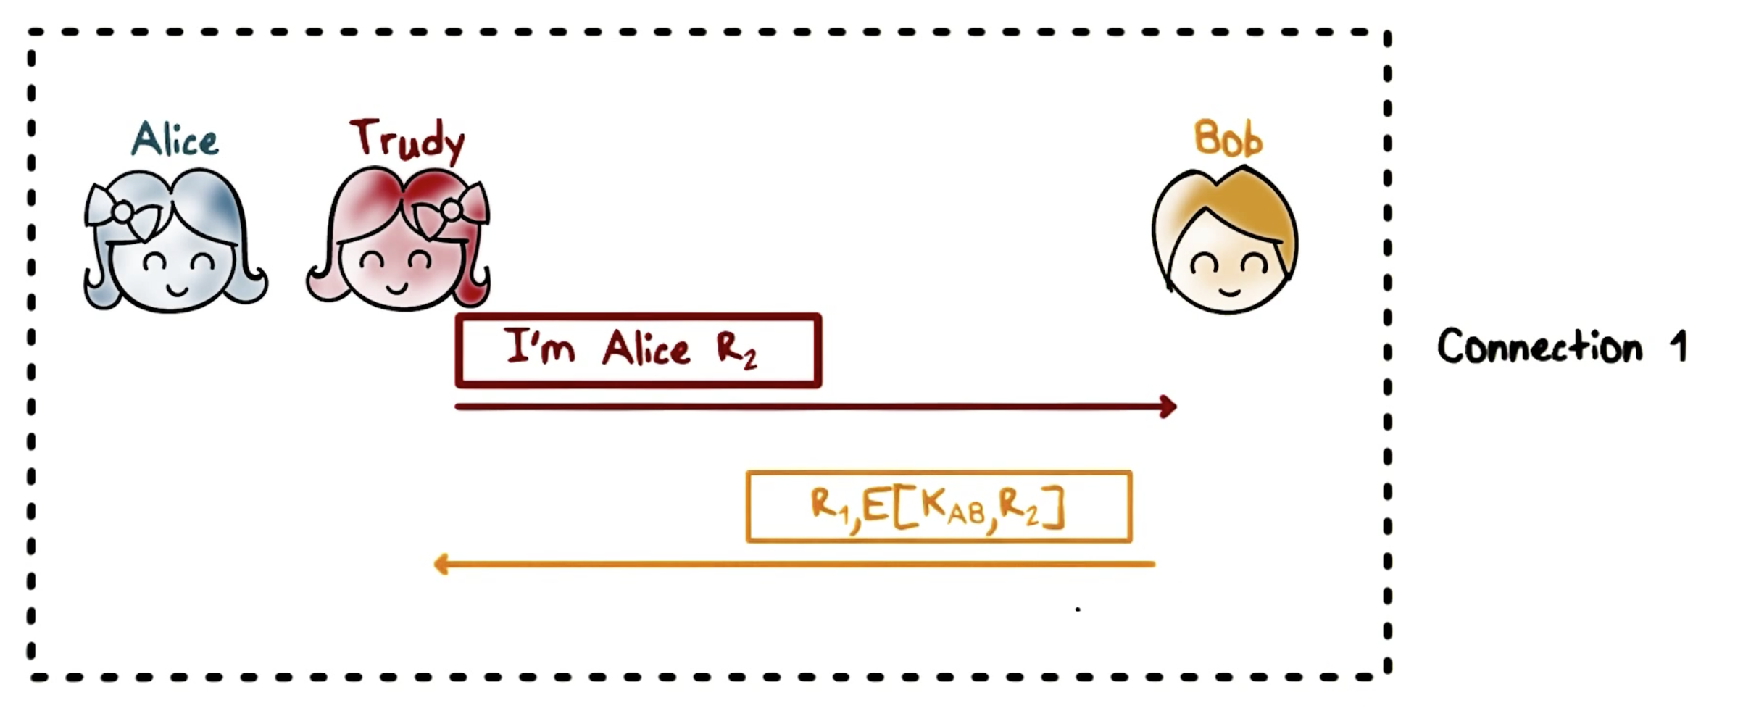
Mutual Authentication: Reflection Attack
Notes:
It turns out that there is a reflection attack, a kind of man-in-the-middle scheme.
Here is how it works:
First, Trudy impersonates Alice. By following the protocol, Trudy will be stuck at step 3 because she cannot the challenge R_1 sent from Bob. She does not know the key K_AB.

Slide 9
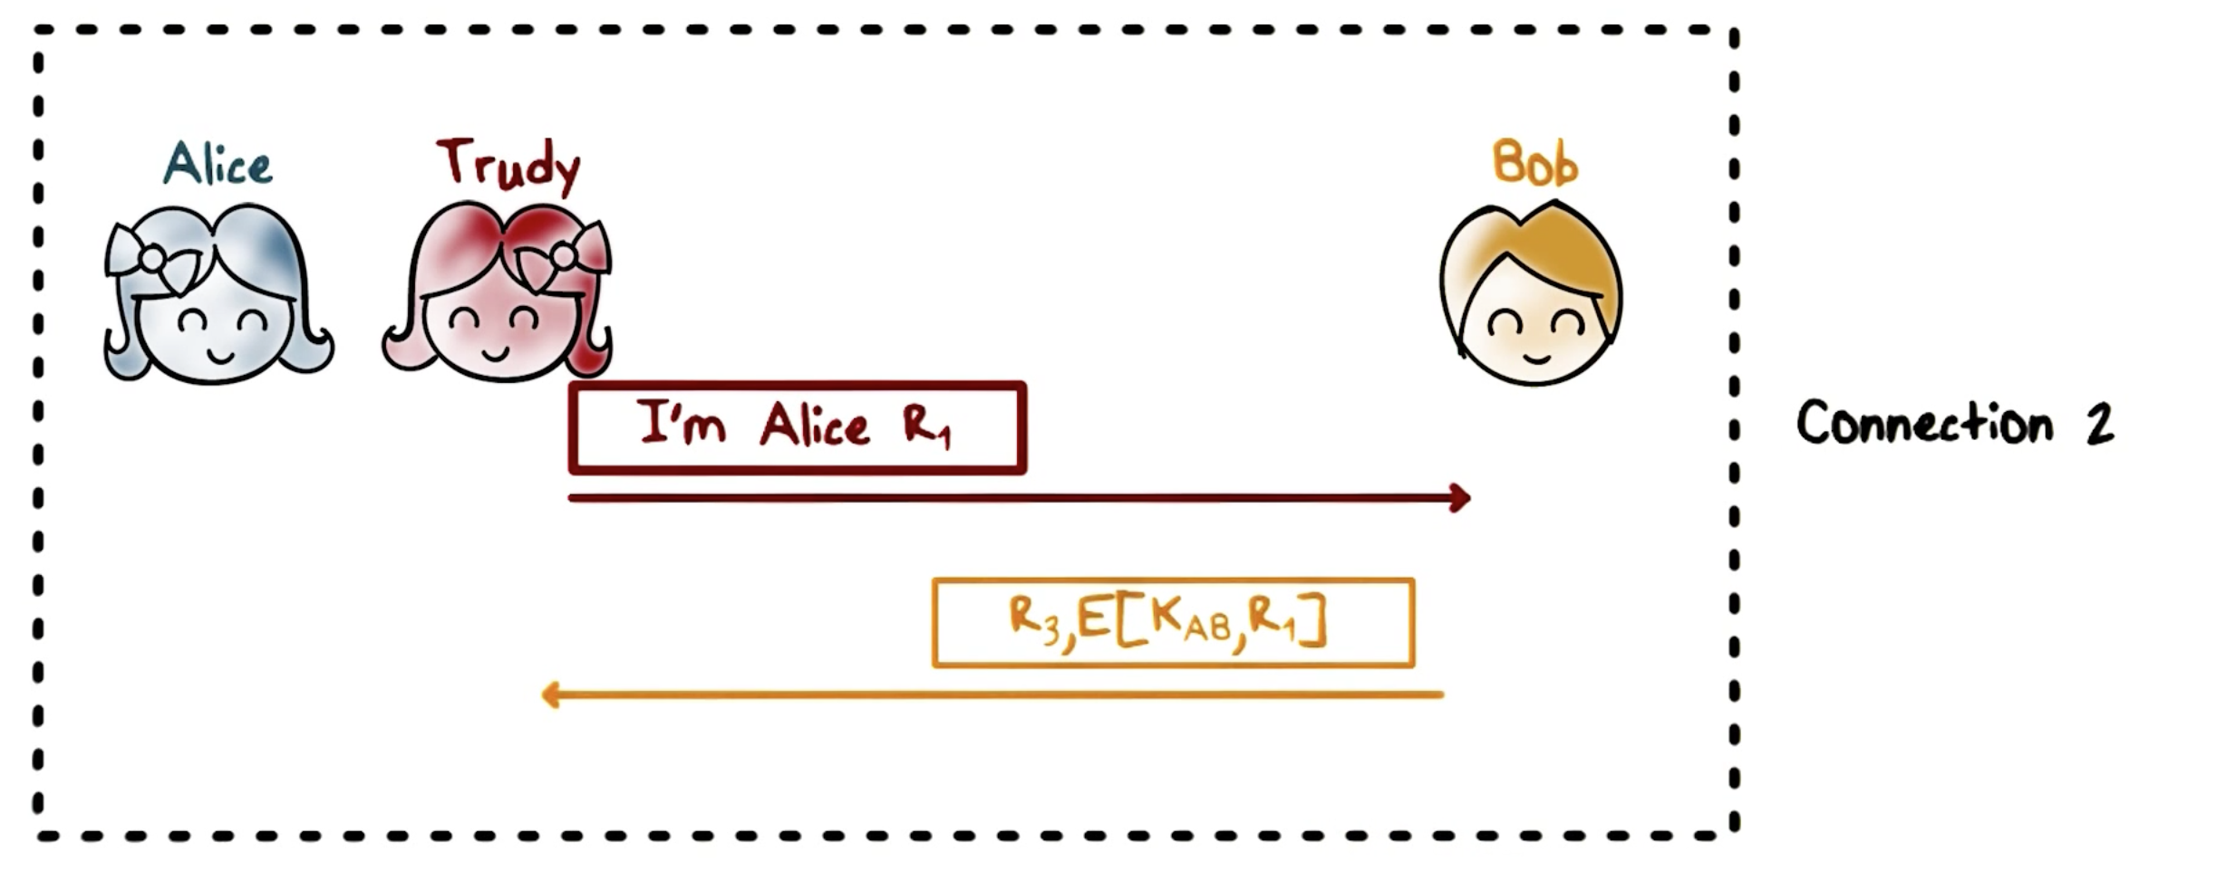
Mutual Authentication: Reflection Attack
Notes:
Then Trudy opens another connection with Bob, again impersonating Alice. This time, Trudy sends Bob the challenge R_1 that Bob had sent her in the first connection, that one that she is stuck in. According to the protocol, Bob responds with the ciphertext of R_1, and another challenge R_3.

Slide 10
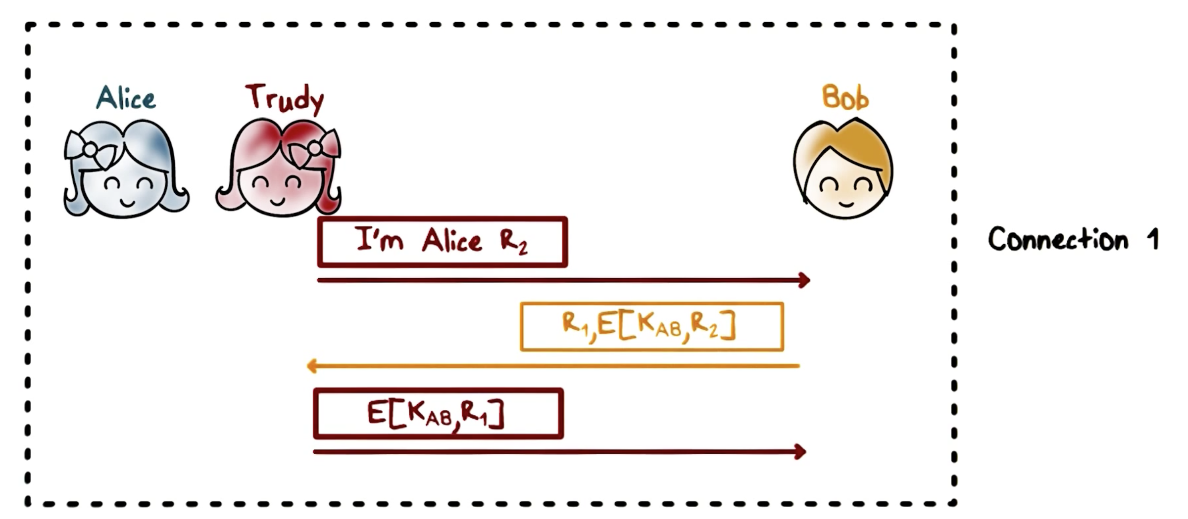
Mutual Authentication: Reflection Attack
Notes:
Trudy can then take the ciphertext of R_1 to complete the step 3 of the first connection, by just sending the ciphertext of R_1 back to Bob. At this point, the first connection successfully concludes and Trudy has successfully impersonated Alice.
This is called a reflection attack because Trudy sends back to Bob what Bob had just sent her from another connection.

Slide 11

Mutual Authentication: Reflection Attack
Fixes:
Different keys for initiator and responder
Trudy can’t get Bob to encrypt using Alice’s key
Notes:
How can we prevent reflection attacks?
One way is two use two different shared keys, one is for the initiator of the connection, say, Alice, and the other for the responder, say Bob.

Slide 12
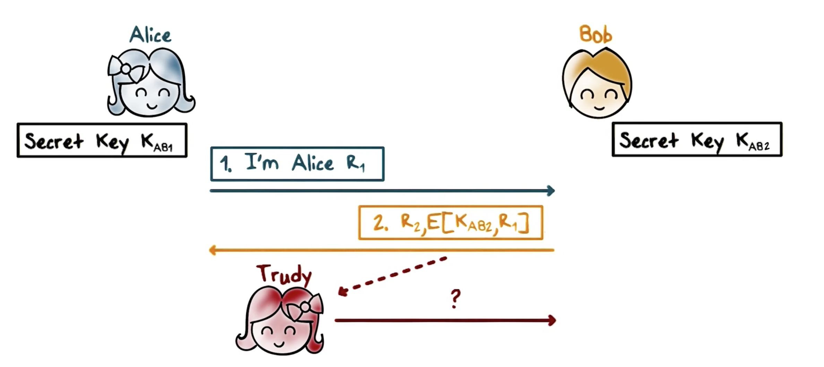
Mutual Authentication: Reflection Attack
Notes:
That is, when Alice encrypts the challenge R_1, she uses a key that is different from the key that Bob uses to encrypt the challenge R_2. Therefore, when Trudy gets the ciphertext R_2 from Bob, she can not just send it back to Bob because Bob is expecting a ciphertext produced using a different key.

Slide 13
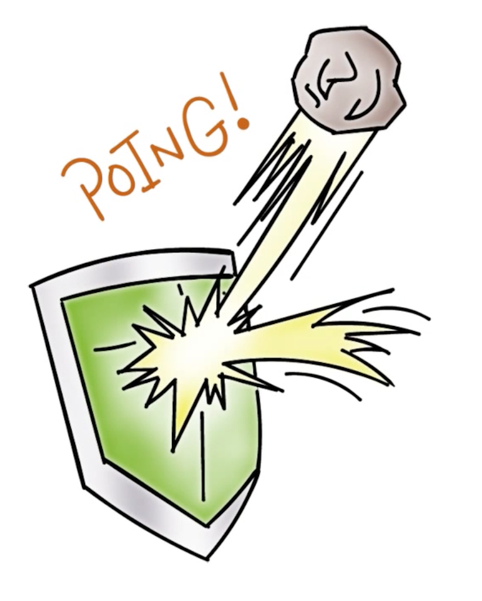
Mutual Authentication: Reflection Attack
Different type of challenges for initiator and responder
e.g., even number for initiator and odd number for responder
Notes:
Another way is the use different challenges for the initiator or responder, e.g., even number challenge for Alice and odd number for Bob. Therefore, when Trudy receives can not send the challenge R_1 she received from Bob, which is an odd number, as a new challenge for Bob because Bob is expecting an even number.

Slide 14
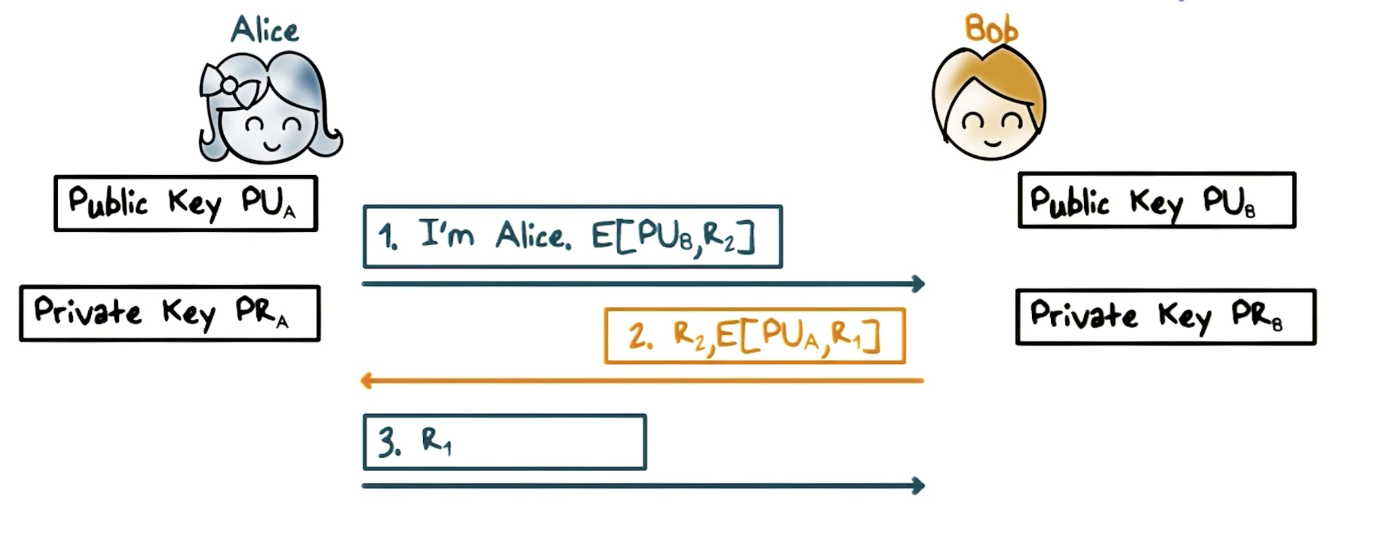
Mutual Authentication Public Keys
Variant:
Sign instead of encrypt
Notes:
We can also use asymmetric cryptography for mutual authentication.
Suppose Alice and Bob have each other’s public key.
Here is the protocol using asymmetric cryptography:
First, Alice sends Bob a challenge R_2 that is encrypted using Bob’s public key;
Second, upon receiving this challenge, Bob decrypts the ciphertext using his private key, and send back the plaintext challenge R_2, along with his own challenge R_1 encrypted using Alice’s private key.
Third, the plaintext R_2 in Bob’s response to Alice tells her that she is communicating with Bob because only Bob has the private key that is paired the public key that encrypted R_2; Alice also decrypts the the ciphertext R_1 using her private key and sends the plaintext to Bob; Bob will then know he is communicating with Alice because only Alice has the private key that is paired with public key used to encrypt R_1.
As an exercise, you can modify this protocol to use signing with private keys instead of encryption with public keys.

Slide 15
Attack Quiz
Mark T for True or F for False:
A reflection attack is a form of man-in-the-middle attack
To defeat a reflection attack, we can use an odd number as challenge from the initiator and even number from the responder
We can use signing with public keys to achieve mutual authentication
Notes:
Quiz:
Discuss
----
Solution:
All True

Slide 16
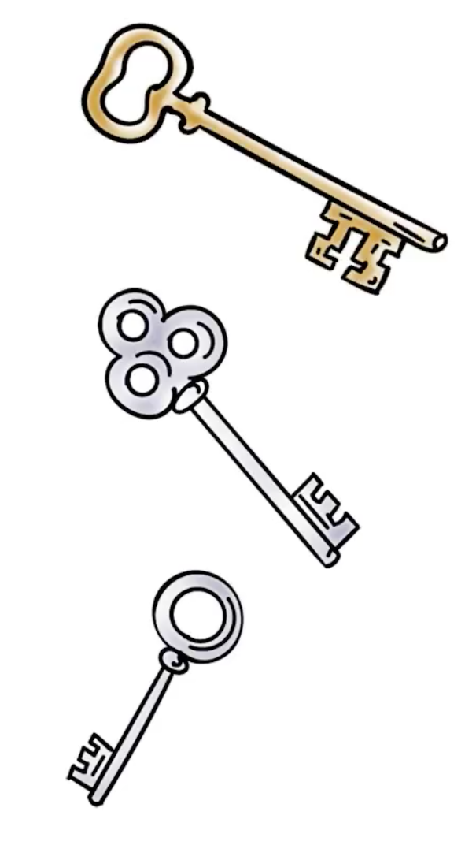
Session Keys
Authentication first
A new key is used for each session
Using shared (master) secret
Encrypt the new key
Using public keys
Notes:
Discuss

Slide 17
Session Keys
Establish a shared key for the session, even if a there is already a shared secret key.
Typically a long term secret key is called a Master key, possibly derived from a password.
The master key is used to authenticate and establish a new session key.
Notes:
After authentication, in order to protect message security, Alice and Bob would need to establish a shared secret key for the session. This is true even if Alice and Bob already has a shared secret key. Typically, Alice and Bob share a long term secret key, and we call it the master key. For example, the master key is derived from a password. For each session, Alice and Bob would use the master secret key to authenticate and establish a new key. Then all messages in the session are protected using the session key.
The main benefit of using a session key is that if the key is leaked or broken, the impact is limited to the current session. Intuitively, the more a secret is used, the higher the chance that the secret can be leaked. Therefore, we should limit the use of the long-term, master secret, and only use it at the beginning of a session for authentication and establishing the session key.

Slide 18
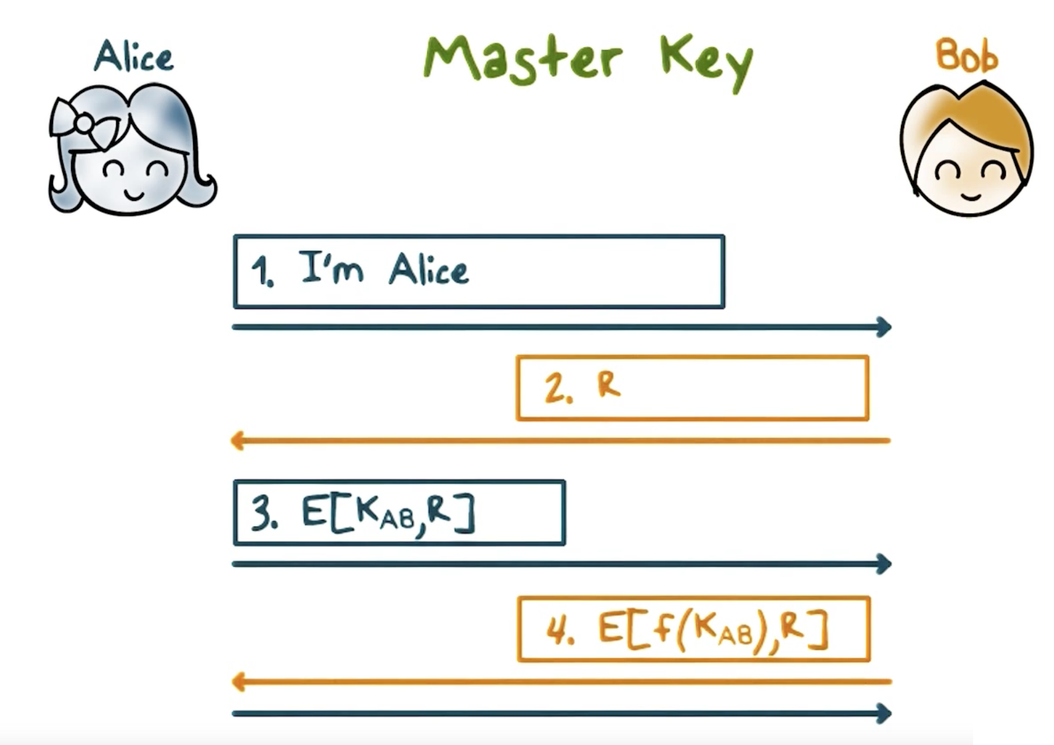
Session Keys
Notes:
Here is an example:
The first three steps are just for Alice to authenticate to Bob, say, Bob is a server.
Then both Alice and Bob compute the same session key that is based on the shared master key and something about the current session, so that the session key is both a secret and unique to the session. So, for example, they can add 100 to the master key, and use the result as the key to encrypt R, and the result is the shared session key.

Slide 19
Session Keys
Alice → Bob: E(PR_{A}, E(PU_{B}, K))
Diffie-Hellman with signing, i.e.,
Alice → Bob: E(PR_{A}, Y^{A})
Bob → Alice: E(PR_{B}, Y^{B})
Notes:
Alice and Bob can also use their public keys to exchange a shared session key.
For example, Alice can send Bob a key, encrypted using Bob’s public key, so that only Bob can decrypt and get the key. and then sign the result using Alice’s private key so that Bob knows that key is sent by Alice.
Or, they can use their private keys to sign the public messages in a Diffie-Hellman key exchange, and this can prevent the man-in-the-middle attack.

Slide 20

Key Distribution Center (KDC)
Shared Master Keys do not scale easily
Each communication pair needs to share a master key
Notes:
One shortcoming of pairwise key-exchange based on shared secret master key is that it does not scale easily. That is, Alice needs to share a master with Bob, another master with Carol, so on and so forth.

Slide 21
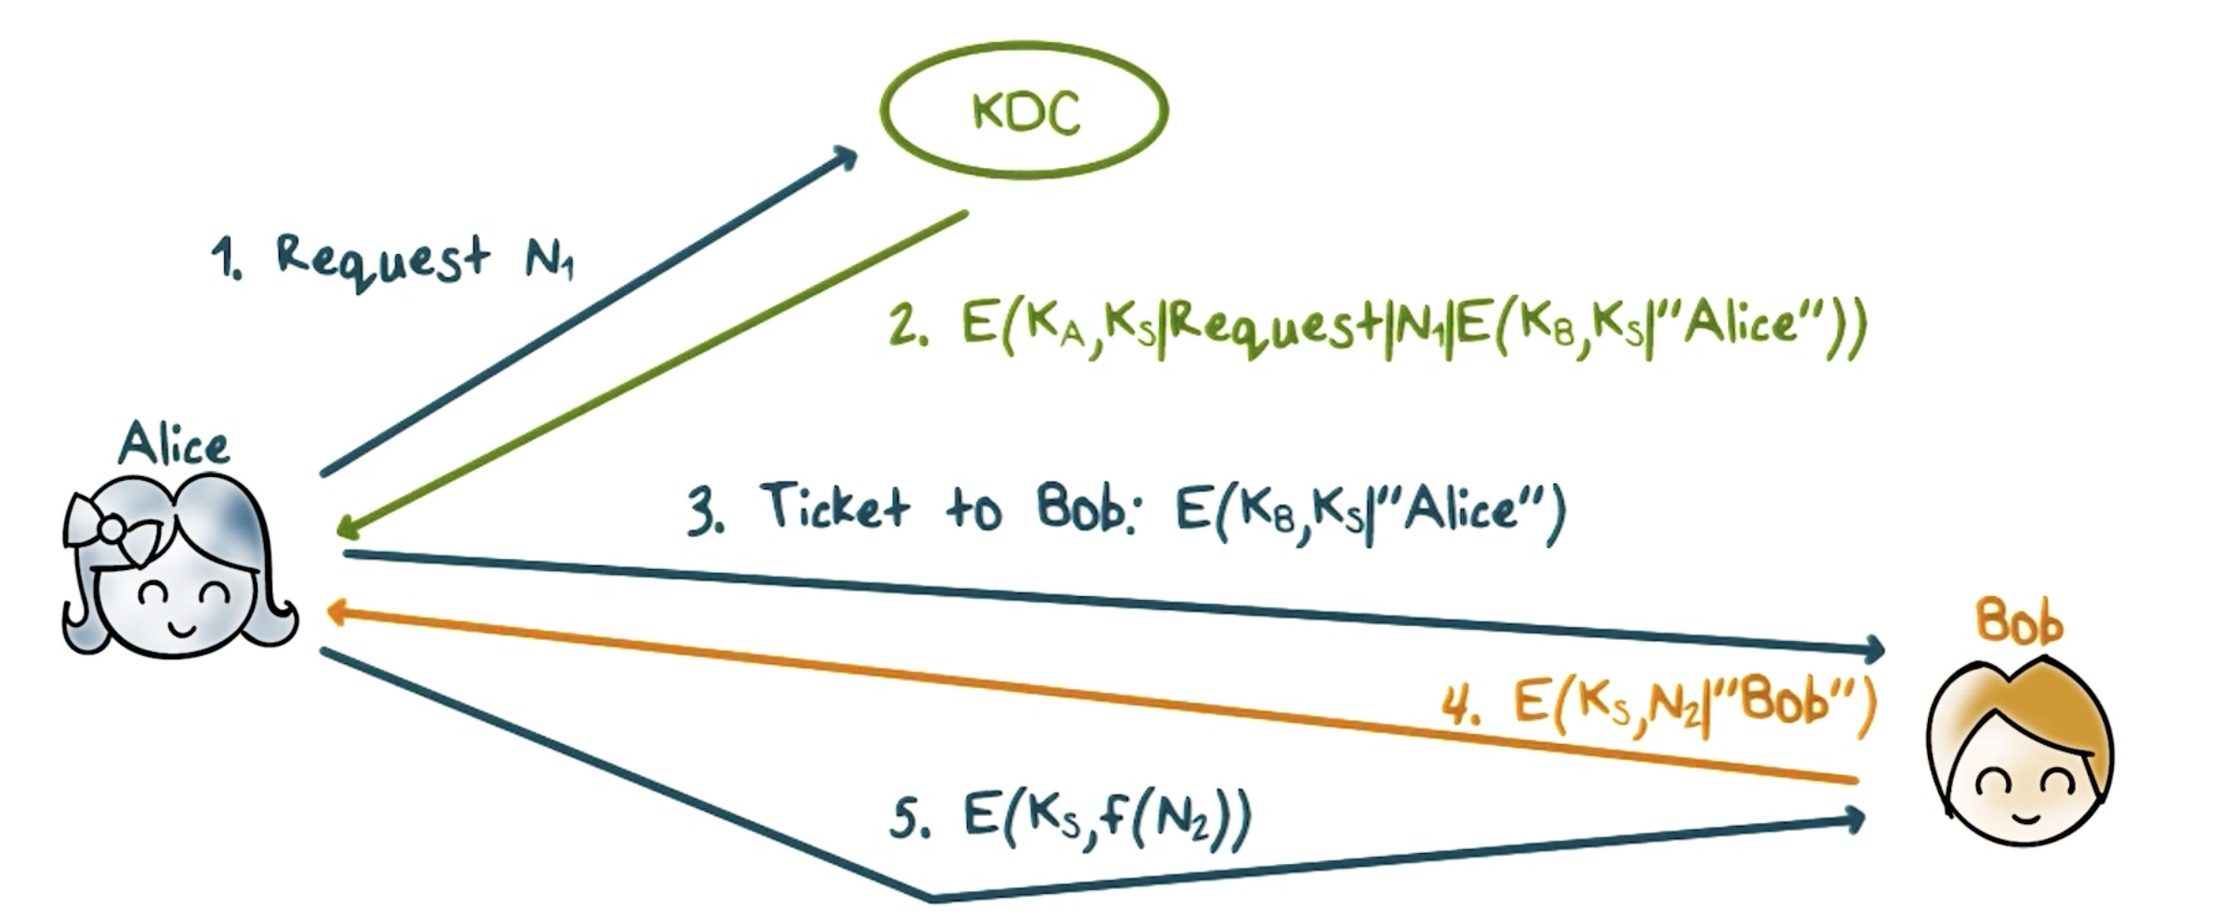
Key Distribution Center (KDC)
K_{A}, K_{B} are master keys shared with KDC, K_{s} is a session key
Notes:
Using a key distribution center can solve this scalability problem. Each user has his or her own master key with the KDC. That is, KDC has many master keys, one for each user, but each user only keeps one master key that is shared with the KDC.
---
Now, suppose that Alice and Bob need to establish a session key,
First, Alice sends a request to KDC, such as “need a key to talk to Bob”, along with a nonce N_1, which is a random value.
Then the KDC sends a message that is encrypted using the master key K_A that is shared between Alice and the KDC. This message contains the session key K_s that the KDC just created for Alice and Bob to share. The same request, nonce N_1, and a message, is called a ticket. The ticket is encrypted using the master K_B that is shared between Bob and the KDC, and it contains the session key K_s and the ID of Alice.
---
When Alice gets back the message from the KDC, she can decrypt it because she has the master key K_A, and so she can get the session key K_s, she knows that the message is from the KDC and is fresh, that is, it is not a replay, because only the KDC can use K_A to encrypt properly a message that contains that request and nonce that she just sent.
Alice then sends the ticket to Bob. Note that only Bob can decrypt the ticket because it is encrypted using K_B, the master key shared between Bob and the KDC. In fact, when Bob decrypts the ticket, he knows that ticket is created by the KDC because only the KDC can encrypt the ID of Alice properly, and he knows that session key K_s was created by the KDC and is for communication with Alice.
----
Then Bob sends a message that contains a nonce N_2 and his ID, encrypted using the session key K_s, to Alice. When Alice receives this message she knows that she is communicating with Bob because only he can decrypt the ticket, get the key K_s and encrypt the ID properly. Alice then performs an agreed-upon transformation on N_2, say, add 100 to N_2, encrypts the result using K_s and sends it to Bob. This proves to Bob that he is communicating with Alice because only she has the session key K_s.

Slide 22
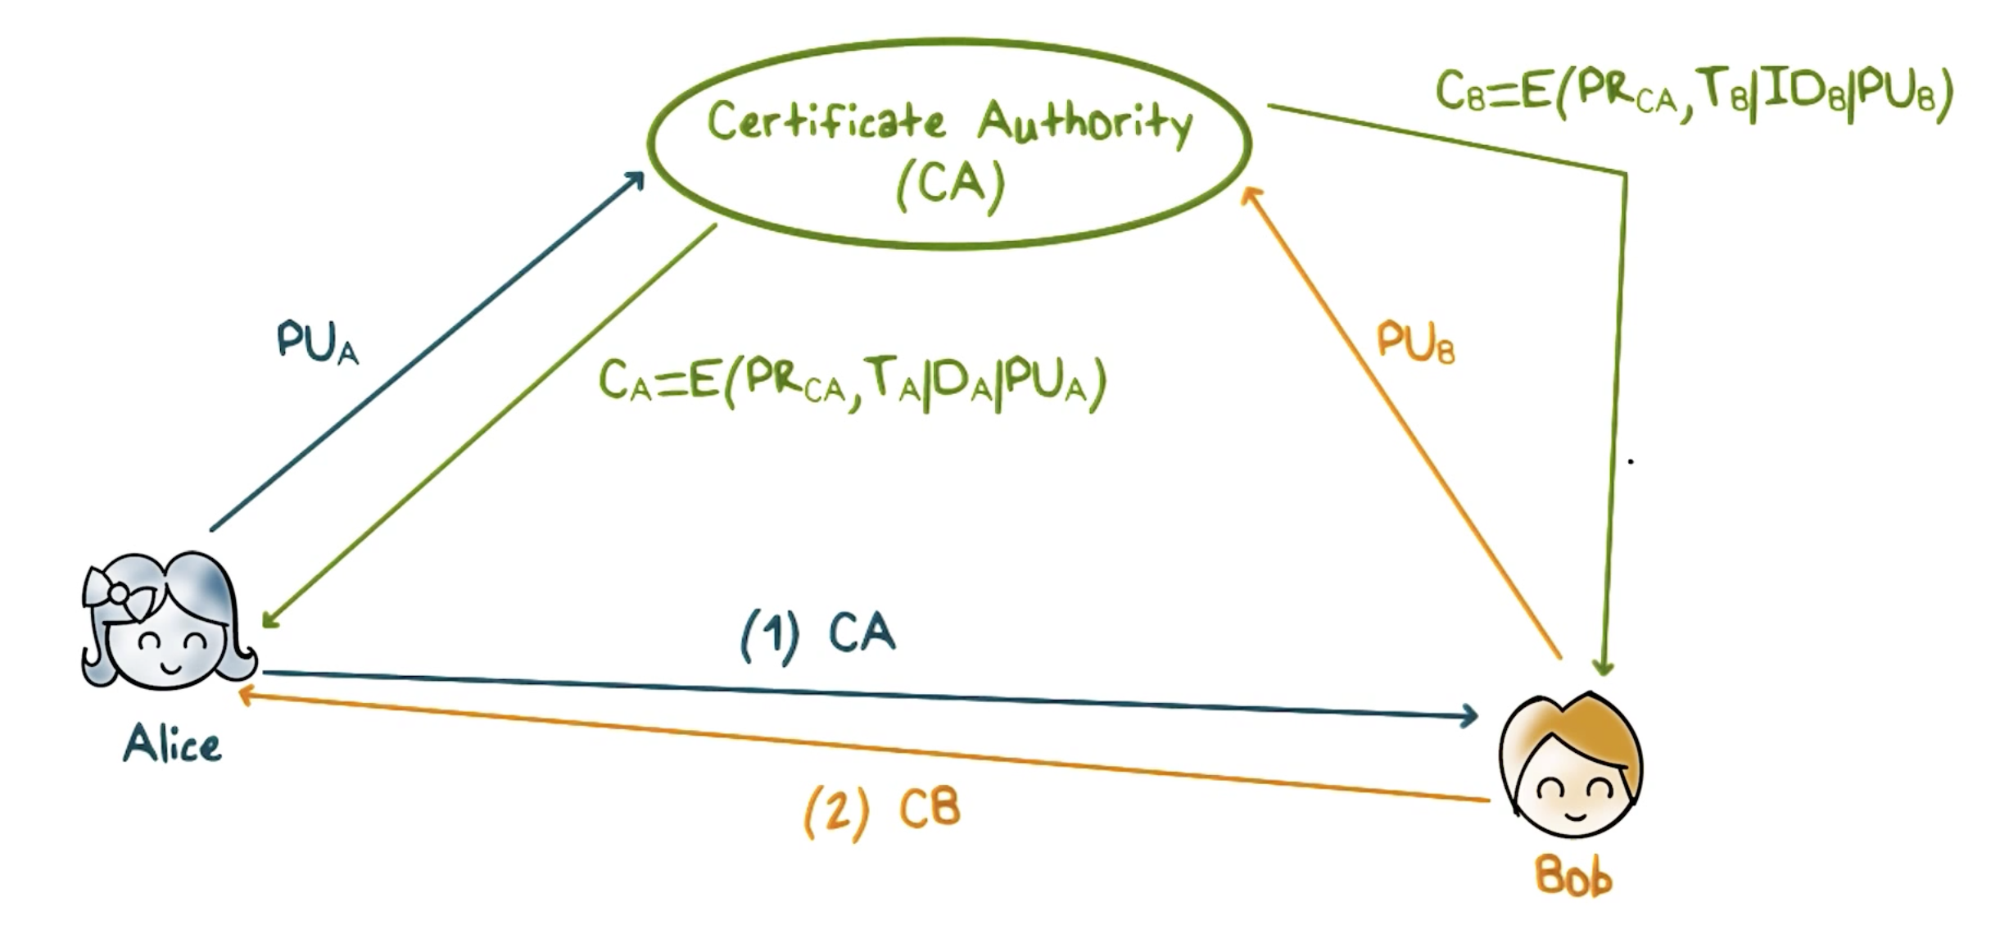
Exchanging Public Key Certificates
Notes:
The distribution of public keys is often done through a certificate authority, CA.
Alice send her public key to the CA. The CA verifies Alice’s identification, and creates a certificate of Alice’s public key and sends it to Alice. The certificate contains time of creation, validity period, and ID of Alice, and her public key, and is signed by the CA’s private key.
----
Alice can then sends this certificate to any user, say, Bob, or simply publish it so that any user can get it. It is assumed all users have the CA’s public key, and therefore, a user, say, Bob, can use the CA’s public key to verify the certificate and obtain Alice’s public key.
----
Likewise, Bob can get his certificate and send it to Alice so that she has his public key.

Slide 23
Session Key Quiz
Mark T for True or F for False:
A session key should be a secret and unique to the session
Authentication should be accomplished before key exchange
A key benefit of using of KDC is for scalability
In order for Bob to verify Alice’s public key, the certificate authority must be on-line
Signing the message exchanges in Diffie-Hellman eliminates the man-in-the-middle attack
Notes:
Quiz:
Discuss
----
Solution:
1. T; 2 T; 3 T; 4 F; 5 T.

Slide 24
Kerberos
Authentication and access control in a network environment
Every principal has a master (secret) key
Human user’s master key is derived from password
Other resources must have their keys configured in
All principals’ master keys are stored in the KDC database, protected/encrypted
Notes:
Now let’s take a look how the principles of authentication and key exchange that we have discussed are used in actual systems.
Kerberos is standard protocol used to provide authentication and access control in a network environment, typically an enterprise network.
Every entity in the network, that is, all users and network resources such as workstations and printers have a master key that it shares with the Kerberos servers, which perform both authentication and key distribution. So for convenience, we use KDC to refer to a Kerberos server.
For a human user, the master key is derived from his or her password, for a network device, the key is configured in.
All the keys are stored securely at the KDC.

Slide 25
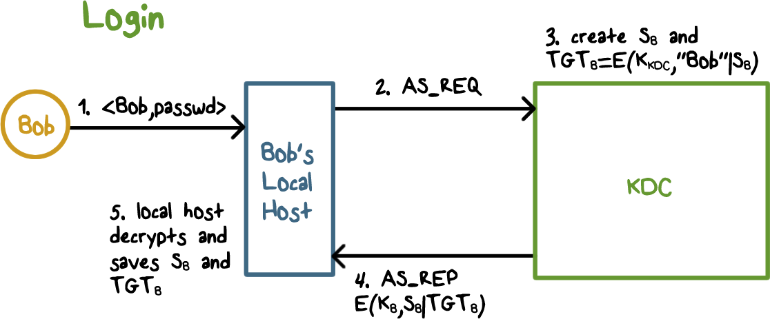
Kerberos
Notes:
Let’s go over a few typical Kerberos scenarios.
When user Bob logs in, his workstation contacts the KDC with a authentication service request (AS_REQ). The KDC generates a per-day session key S_B, and a so-called ticket-granting-ticket that contains S_B and the ID of Bob, and the ticket is encrypted using the KDC’s own key. The KDC then sends a message that include the per-day session key S_B and the TGT_B, encrypted using the key K_B to Bob. Because K_B is the master key shared between Bob and KDC, only Bob’s local host can decrypt this message, and stores the per-day session key S_B and TGT_B.
Bob’s local host uses S_{B}, for subsequent message with KDC, and uses TGT_B, for reminding/convincing KDC to use S_{B} with it as well. That is, New request to KDC must include TGT in the request message and new tickets from KDC must be decrypted with S_{B}

Slide 26

Kerberos
Kerberos Benefits:
Localhost does not need to store passwords
The master key that the user shares with the KDC is only used once every day
This limits exposure of the master key
Notes:
This has several benefits. First, the local host does not need to store Bob’s password once Bob has logged in and it has obtained S_B from the KDC. Second, the master key K_B that Bob shares with the KDC is only used once every day when Bob logs in. That is the exposure of the master key, which is derived from Bob’s password and is subject to password-guessing attacks, is limited.

Slide 27
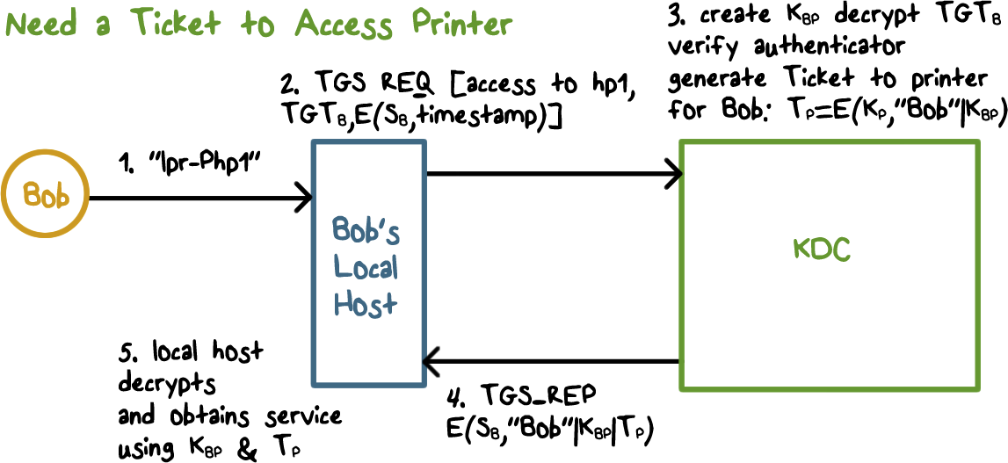
Accessing the Printer
Notes:
Now suppose Bob wants to access the printer hp1.
His local host sends a ticket granting service request (TGS_REQ) to the KDC. The request contains the TGT_B and and authenticator, which is the current timestamp encrypted using Bob’s per-day key S_B.
When the KDC gets this request, it can decrypt the TGT_B, it knows it is an valid TGT because only it has the key to properly encrypt the ID of Bob contained in the TGT, it then uses the S_B contained in the TGT to verify the authenticator by decrypting it and check the timestamp is current. This proves that the sender is Bob because only Bob has the key S_B that can encrypt the current timestamp properly. The KDC then generates a ticket for Bob to communicate with the printer. It contains a session key K_BP, and Bob’s ID, and is encrypted using the printer’s master key. Note that a network device such as a printer has a long and random master key that is configured in, and it is typically hard to guess or crack. Therefore, the ticket for these devices is encrypted using their master keys.

Slide 28
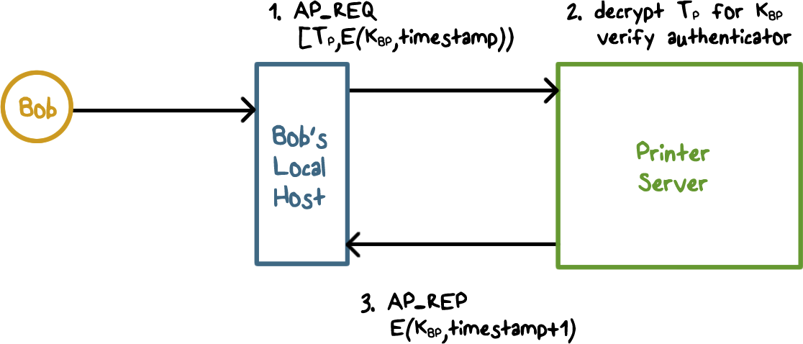
Accessing the Printer
Notes:
The KDC sends the ticket granting service response to Bob’s local host. It contains the session key K_BP, the ID of Bob, and the ticket to the printer, and it is encrypted using Bob’s per-day key S_B. Therefore, only Bob’s local host can decrypt this, and verify that it is from the KDC because only the KDC can encrypt the ID of Bob correctly with the key S_B. It can the record the key K_BP, and ticket for the printer.

Slide 29
Kerberos Quiz
Mark T for True or F for False:
Kerberos provides authentication and access control
Kerberos also distributes session keys
To avoid over-exposure of a user’s master key, Kerberos uses a per-day key and a ticket-granting-ticket
The authenticators used in requests to KDC and application servers can be omitted
Access to any network resource requires a ticket issued by the KDC
Notes:
Quiz:
Discuss
----
Solution:
1. T; 2 T; 3 T; 4 F; 5 T.

Slide 30
Security Protocols
Lesson Summary
Secret key based and public key based authentication
Random challenge and response
Impersonation attacks
Establish session key based on pre-shared secret key or public keys and authentication exchanges, use KDC or CA
Kerberos: authentication and access control, tickets, and ticket-granting ticket.
Notes:
In this lecture, we have discussed one-way and mutual authentication protocols using secret key or public keys. It is important that the challenges are randomly generated, and carefully consider the possibility of attackers capturing the challenge-and-response and launch impersonation attacks.
We have also discussed protocols to establish session key, which can use pre-shared key or public keys and the random challenge used in authentication. Key distribution center is often used to establishing and distributing session keys, and certificate authority is used to generate and sign public key certificate that can be distributed and verified.
Kerberos system is used for authenticating users and devices on a network and enforce access control. Each access requires a ticket, and a ticket-granting ticket after user login is used to request such tickets to access devices.

